Slide 1
Estimating ET
METR 5633 - Hydrometeorology

Slide 2
Class A Evaporation Pan
An Official Measurement of the US National Weather Service
Cylinder diameter is 47.5 in (120.7 cm)
Cylinder depth is 10 in (25 cm)
Filled with water to a depth of 2 in below the top.
After 24 hours (day), the depth to refill the pan is the total evaporation.
Not necessarily representative of a soil/vegetated environment

Slide 3
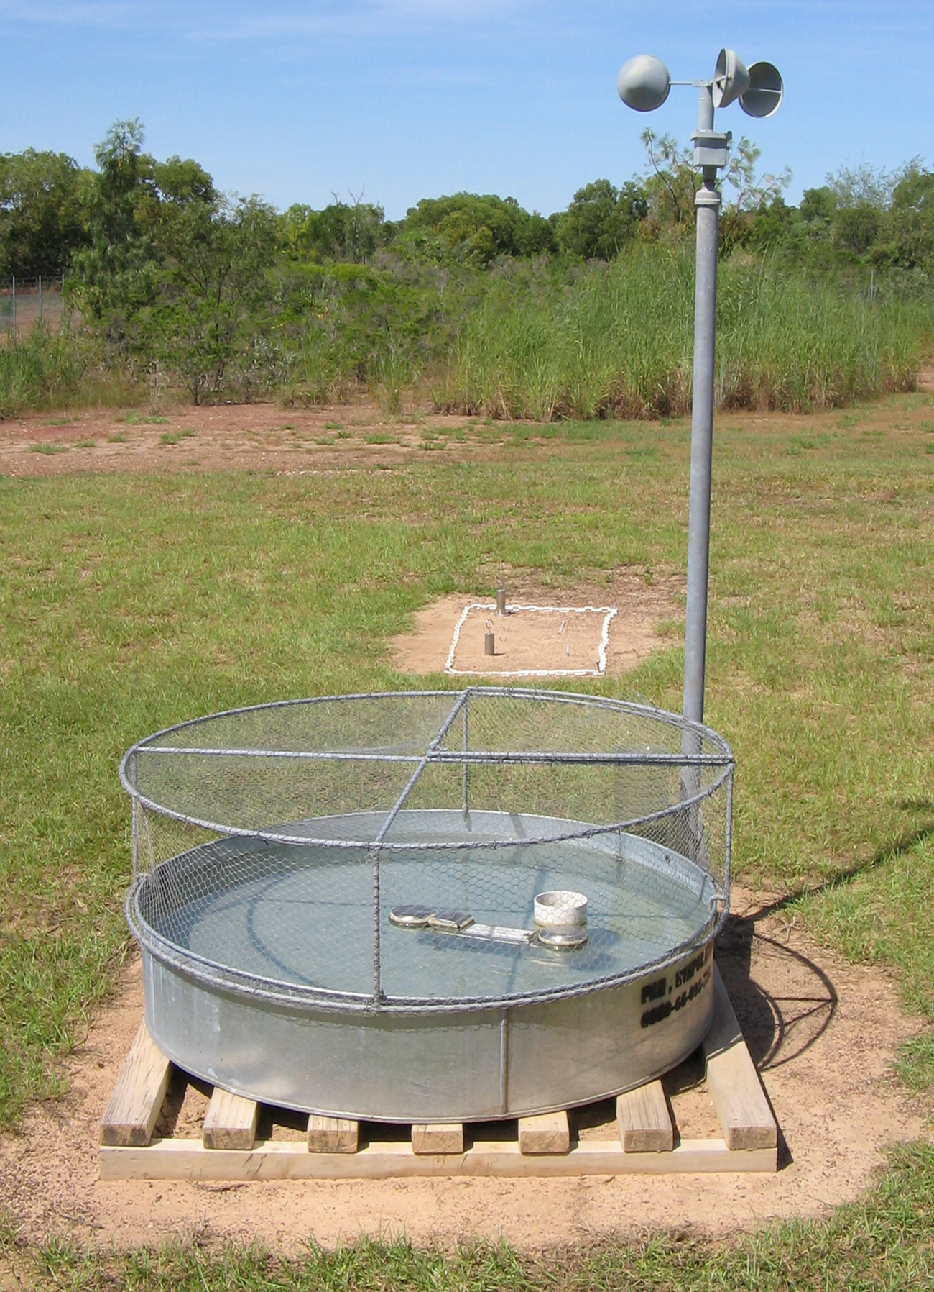
Evaporation Pan Method
2-m Wind Speed via cup anemometer
Water
Metal Pan
Class A evaporation pan has a cylinder with a diameter of 47.5 in (120.7 cm) that has a depth of 10 in (25 cm).

Slide 4
Pan Evaporation Limitations

Slide 5
Potential Evaporation
The amount of water that would be evaporated and transpired by a specific crop or ecosystem if sufficient water is available.
Potential evapotranspiration is higher during increased temperature and increased solar radiation given the higher amount of solar radiation required for evaporation. (HINT – Think SEB)

Slide 6
Penman-Montieth Method
The FAO Penman-Monteith method is maintained as the sole standard method for the computation of crop reference evapotranspiration (ET_{o}) from meteorological data.
It can also be measured as the evaporation loss from a water surface.
Generally, the Penman-Monteith equation determines the evapotranspiration from a hypothetical “grass” reference surface.
The only factors affecting ET_{o} are climatic variables.

Slide 7
Penman-Montieth Equation
R_{n} is the net radiation
G is the soil heat flux
(e_{s} - e_{a}) represents the vapor pressure deficit of the air
r _{a} is the mean air density at constant pressure
c_{p} is the specific heat of the air
Δ represents the slope of the saturation vapor pressure temperature relationship
γ is the psychrometric constant
r_{s} and r_{a} are the (bulk) surface and aerodynamic resistances.

Slide 8
Aerodynamic Resistance (r_{a})
r_{a} aerodynamic resistance [s m⁻¹], z_{m} height of wind measurements [m], z_{h} height of humidity measurements [m], d zero plane displacement height [m], z_{om} roughness length governing momentum transfer [m], z_{oh} roughness length governing transfer of heat and vapor [m], k von Karman's constant, 0.41 [-], u_{z} wind speed at height z [m s⁻¹].

Slide 9
Bulk Surface Resistance (r_{s})
r_{s} (bulk) surface resistance [s m⁻¹], r_{l} bulk stomatal resistance of the well-illuminated leaf [s m⁻¹], LAI_{active} active (sunlit) leaf area index [m² (leaf area) m⁻² (soil surface)].
LAI is the leaf area index.

Slide 10
Penman-Montieth (FAO) Equation
ET_{o} reference evapotranspiration [mm day⁻¹], R_{n} net radiation at the crop surface [MJ m⁻² day⁻¹], G soil heat flux density [MJ m⁻² day⁻¹], T air temperature at 2 m height [°C], u₂ wind speed at 2 m height [m s⁻¹], e_{s} saturation vapor pressure [kPa], e_{a} actual vapor pressure [kPa], e_{s} - e_{a} saturation vapor pressure deficit [kPa], Δ slope vapor pressure curve [kPa °C⁻¹], γ psychrometric constant [kPa °C⁻¹].

Slide 11
Penman-Montieth Method
Temperature
The average daily temperatures in degrees Celsius (°C) is computed from the maximum and minimum air temperature values.
Humidity
The (average) daily actual vapor pressure, e_{a}, in kilopascals (kPa) is computed similar to temperature.
Radiation
The (average) daily net radiation expressed in megajoules per square metre per day (MJ m⁻² day⁻¹) is required. When not available the values can be derived from the (average) shortwave radiation measured with a pyranometer.
Wind speed
The (average) daily wind speed in meters per second (m s⁻¹) measured at 2 m above the ground level is required.

Slide 12
Schematic View of Penman-Montieth Method

Slide 13
Penman-Montieth Method Applied to Crops (Et_{c})
Specific Crop Coefficient

Slide 14
Example of Penman-Montieth Method Applied to Sugarcane
Silva, V. , Borges, C. , Farias, C. , Singh, V. , Albuquerque, W. and Silva, B. (2012) Water requirements and single and dual crop coefficients of sugarcane grown in a tropical region, Brazil. Agricultural Sciences, 3, 274-286.

Slide 15
Penman-Montieth Method Applied to Stressed Crops (Et_{c adj})
Crop Stress Coefficient
Specific Crop Coefficient

Slide 16


Aerodynamic Resistance (r_{a}) Applied LE Fluxes
$$\text{LH}= \frac{\text{gr}\text{(}\text{q}\text{s}\text{ - }\text{qa}\text{)} }{\text{r}\text{a} }$$
$$\text{SH}= \frac{\text{r}\text{C}\text{p}\text{(}\text{Ts}\text{ - }\text{T}\text{a}\text{)} }{\text{r}\text{a} }$$
r_{a} aerodynamic resistance [s m⁻¹], q_{s} specific humidity of the surface [g_{vapor} kg⁻¹_{moist air}], q_{a} specific humidity of the atmosphere [g_{vapor} kg⁻¹_{moist air}], T_{s} Temperature of the surface [°C], q_{a} Temperature of the atmosphere [°C], C_{p} Specific Heat of the air γ psychrometric constant [kPa °C⁻¹].
ρ density of moist air [kg m⁻³]
Notes:
a

Slide 17
Questions?

